Slide 1
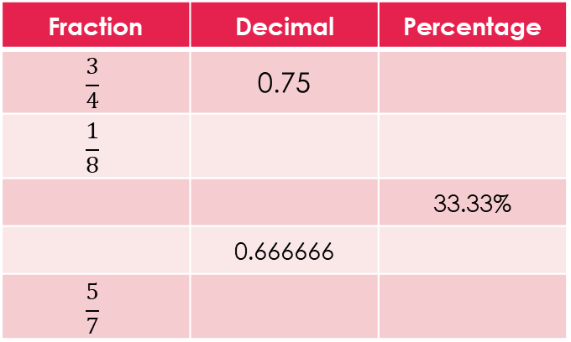
Topic: Two step Probability with replacement EQ: What is experimental probability with replacement?
Review questions (on LHS)
Complete the table
Steps to be successful this lesson:
Get materials out (notebook, pen, pencil, ruler, calculator)
Rule up notebook and write Topic and EQ
Start on review questions →
Check your answers with someone sitting next to you
Is your notebook up to date? (Contents page, glossary, review notes etc.)
Fraction | Decimal | Percentage
$$\frac{3}{4}$$ | 0.75
$$\frac{1}{8}$$
 |  | 33.33%
 | 0.666666
$$\frac{5}{7}$$

Slide 2
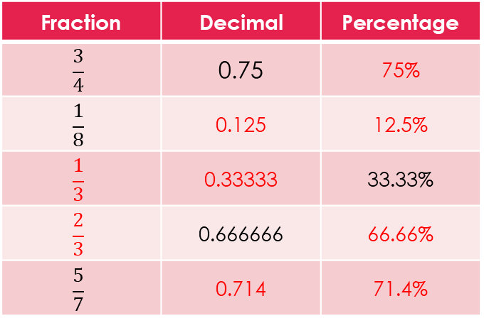
Topic: Two step Probability with replacement EQ: What is experimental probability with replacement?
Review questions (on LHS)
Complete the table
Steps to be successful this lesson:
Get materials out (notebook, pen, pencil, ruler, calculator)
Rule up notebook and write Topic and EQ
Start on review questions →
Check your answers with someone sitting next to you
Is your notebook up to date? (Contents page, glossary, review notes etc.)
Fraction | Decimal | Percentage
$$\frac{3}{4}$$ | 0.75 | 75%
$$\frac{1}{8}$$ | 0.125 | 12.5%
$$\frac{1}{3}$$ | 0.33333 | 33.33%
$$\frac{2}{3}$$ | 0.666666 | 66.66%
$$\frac{5}{7}$$ | 0.714 | 71.4%

Slide 3
Two Step Probability With Replacement
Year 9

Slide 4

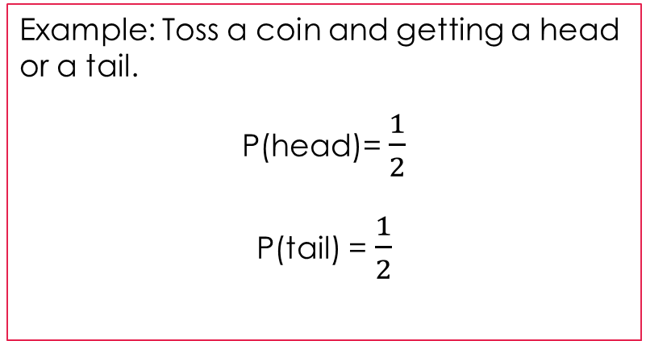
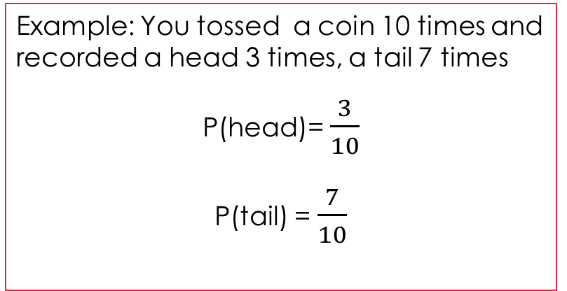
24
7
30
Topic: Two step Probability with replacement
Date:
EQ – What is experimental probability with replacement?
Probabilty can have two approaches:
Experimental Probability and Theoretical Probability
What actually happens vs. What we think will happen
P (event) = $\frac{number of times event occurs}{total number of trials}$ P (event) = $\frac{number of favorable outcomes}{number of possible outcomes}$
Experimental vs. Theoretical
Example: You tossed a coin 10 times and recorded a head 3 times, a tail 7 times
P(head)= $\frac{3}{10}$
P(tail) = $\frac{7}{10}$
Example: Toss a coin and getting a head or a tail.
P(head)= $\frac{1}{2}$
P(tail) = $\frac{1}{2}$

Slide 5
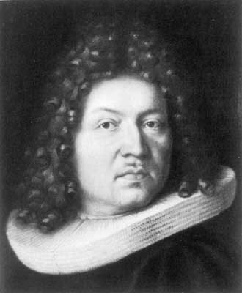
24
7
30
Topic: Two step Probability with replacement
Date:
EQ – What is experimental probability with replacement?
Probabilty can have two approaches:
Experimental Probability and Theoretical Probability
What actually happens vs. What we think will happen
P (event) = $\frac{number of times event occurs}{total number of trials}$ P (event) = $\frac{number of favorable outcomes}{number of possible outcomes}$
Experimental vs. Theoretical
The Law of Large numbers
The Law of Large Numbers was first published in 1713 by Jocob Bernoulli.
It is a fundamental concept for probability and statistic.
This Law states that as the number of trials increase, the experimental probability will get closer and closer to the theoretical probability.

Slide 6
24
7
30
Topic: Two step Probability with replacement
Date:
EQ – What is experimental probability with replacement?
A two – way table is one way to display the outcome of a 2 step experiment, we use the results to calculate probability.
Example
a dice is thrown and a coin is tossed. Determine the possible outcomes
Two Way Table
 | 1 | 2 | 3 | 4 | 5 | 6

Slide 7
24
7
30
Topic: Two step Probability with replacement
Date:
EQ – What is experimental probability with replacement?
A two – way table is one way to display the outcome of a 2 step experiment, we use the results to calculate probability.
Example
a dice is thrown and a coin is tossed. Determine the possible outcomes
Two Way Table
 | 1 | 2 | 3 | 4 | 5 | 6
Heads
Tails

Slide 8
24
7
30
Topic: Two step Probability with replacement
Date:
EQ – What is experimental probability with replacement?
A two – way table is one way to display the outcome of a 2 step experiment, we use the results to calculate probability.
Example
a dice is thrown and a coin is tossed. Determine the possible outcomes
Two Way Table
 | 1 | 2 | 3 | 4 | 5 | 6
Heads | 1, Heads | 2, Heads | 3, Heads | 4, Heads | 5, Heads | 6, Heads
Tails | 1, Tails | 2, Tails | 3, Tails | 4, Tails | 5, Tails | 6, Tails

Slide 9
24
7
30
Topic: Two step Probability with replacement
Date:
EQ – What is experimental probability with replacement?
A two – way table is one way to display the outcome of a 2 step experiment, we use the results to calculate probability.
Example
a dice is thrown and a coin is tossed. Determine the possible outcomes
What is the probability of;
1. getting a 4 and a tails? P(4 and T)
Two Way Table
 | 1 | 2 | 3 | 4 | 5 | 6
Heads | 1, Heads | 2, Heads | 3, Heads | 4, Heads | 5, Heads | 6, Heads
Tails | 1, Tails | 2, Tails | 3, Tails | 4, Tails | 5, Tails | 6, Tails

Slide 10

24
7
30
Topic: Two step Probability with replacement
Date:
EQ – What is experimental probability with replacement?
A two – way table is one way to display the outcome of a 2 step experiment, we use the results to calculate probability.
Example
a dice is thrown and a coin is tossed. Determine the possible outcomes
What is the probability of;
1. getting a 4 and a tails? P(4 and T) = $\frac{1}{12}$
Two Way Table
 | 1 | 2 | 3 | 4 | 5 | 6
Heads | 1, Heads | 2, Heads | 3, Heads | 4, Heads | 5, Heads | 6, Heads
Tails | 1, Tails | 2, Tails | 3, Tails | 4, Tails | 5, Tails | 6, Tails

Slide 11

24
7
30
Topic: Two step Probability with replacement
Date:
EQ – What is experimental probability with replacement?
A two – way table is one way to display the outcome of a 2 step experiment, we use the results to calculate probability.
Example
a dice is thrown and a coin is tossed. Determine the possible outcomes
What is the probability of;
1. 4 and a tails? P(4 and T) = $\frac{1}{12}$
2. <5 and heads? P(<5 and H) =
Two Way Table
 | 1 | 2 | 3 | 4 | 5 | 6
Heads | 1, Heads | 2, Heads | 3, Heads | 4, Heads | 5, Heads | 6, Heads
Tails | 1, Tails | 2, Tails | 3, Tails | 4, Tails | 5, Tails | 6, Tails

Slide 12

24
7
30
Topic: Two step Probability with replacement
Date:
EQ – What is experimental probability with replacement?
A two – way table is one way to display the outcome of a 2 step experiment, we use the results to calculate probability.
Example
a dice is thrown and a coin is tossed. Determine the possible outcomes
What is the probability of;
1. 4 and a tails? P(4 and T) = $\frac{1}{12}$
2. <5 and heads? P(<5 and H) = $\frac{4}{12}\text{= }\frac{1}{3}$
Two Way Table
 | 1 | 2 | 3 | 4 | 5 | 6
Heads | 1, Heads | 2, Heads | 3, Heads | 4, Heads | 5, Heads | 6, Heads
Tails | 1, Tails | 2, Tails | 3, Tails | 4, Tails | 5, Tails | 6, Tails

Slide 13

24
7
30
Topic: Two step Probability with replacement
Date:
EQ – What is experimental probability with replacement?
A two – way table is one way to display the outcome of a 2 step experiment, we use the results to calculate probability.
Example
a dice is thrown and a coin is tossed. Determine the possible outcomes
What is the probability of;
1. 4 and a tails? P(4 and T) = $\frac{1}{12}$
2. <5 and heads? P(<5 and H) = $\frac{4}{12}\text{= }\frac{1}{3}$
3. anything but 3?
Two Way Table
 | 1 | 2 | 3 | 4 | 5 | 6
Heads | 1, Heads | 2, Heads | 3, Heads | 4, Heads | 5, Heads | 6, Heads
Tails | 1, Tails | 2, Tails | 3, Tails | 4, Tails | 5, Tails | 6, Tails

Slide 14

24
7
30
Topic: Two step Probability with replacement
Date:
EQ – What is experimental probability with replacement?
A two – way table is one way to display the outcome of a 2 step experiment, we use the results to calculate probability.
Example
a dice is thrown and a coin is tossed. Determine the possible outcomes
What is the probability of;
1. 4 and a tails? P(4 and T) = $\frac{1}{12}$
2. <5 and heads? P(<5 and H) = $\frac{4}{12}\text{= }\frac{1}{3}$
3. anything but 3? P(3) = $\frac{10}{12}$ = $\frac{5}{6}$
Two Way Table
 | 1 | 2 | 3 | 4 | 5 | 6
Heads | 1, Heads | 2, Heads | 3, Heads | 4, Heads | 5, Heads | 6, Heads
Tails | 1, Tails | 2, Tails | 3, Tails | 4, Tails | 5, Tails | 6, Tails

Slide 15


Slide 16

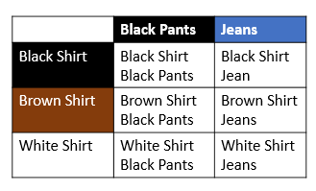
Worked example.
Jeff owns a brown shirt, a white shirt and a black shirt. He also owns a pair of black pants and a pair of blue jeans. How many combinations can he make from these items.
What is the probability that;
today Jeff is wearing a white shirt and blue jeans?
today Jeff is wearing a brown shirt and blue jeans?
today Jeff is not wearing a white shirt?

